Slide 1
Non-Context-Free language
Shakir Ullah Shah

Slide 2
Non-Context-Free language
There arises a question, whether all languages are CFL? The answer is no.
Languages which are not Context-Free are called Non-CFL.
To prove the claim that all languages are not Context-Free, the study of machines of word production from the grammar is needed

Slide 3
Terminology
Live production:
Nonterminal → Nonterminals Nonterminals
Dead production:
Nonterminal → terminal
It may be noted that every CFG in CNF has only these types of productions.

Slide 4
Theorem 32
If a CFG is in CNF and if there is restriction to use the live production at most once each, then only the finite many words can be generated.
It may be noted that every time a live production is applied during the derivation of a word it increases the number of non-terminals by one.
Similarly applying dead production decreases the non-terminals by one. Which shows that to generate a word, one more dead production are applied than the live productions e.g.

Slide 5
Example
S => XY
=> aY
=> ab

Slide 6
Example
S => XY
=> aY
=> ab
Here one live and two dead productions are used to generate a word ab.

Slide 7
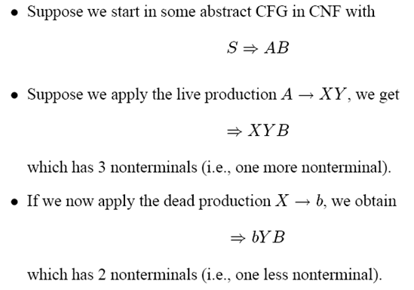
Proof of Theorem 32

Slide 8
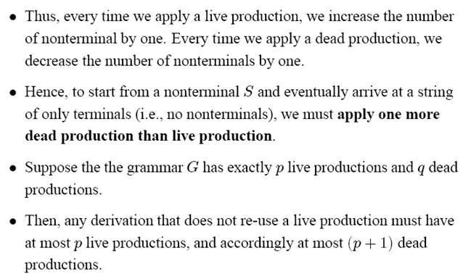
Proof of Theorem 32

Slide 9
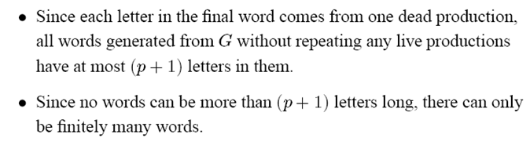
Proof of Theorem 32

Slide 10
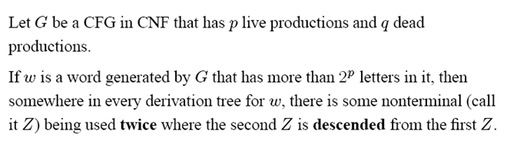
Theorem 33

Slide 11
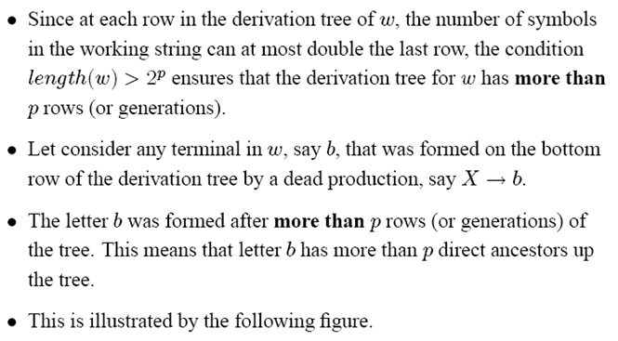
Proof of Theorem 33

Slide 12
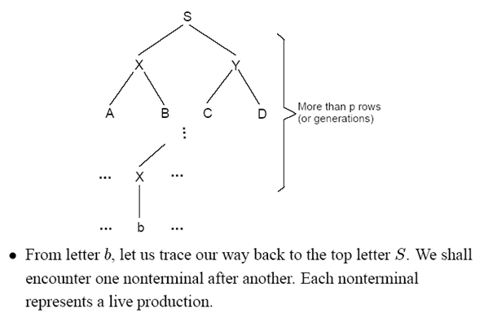
Proof of Theorem 33

Slide 13
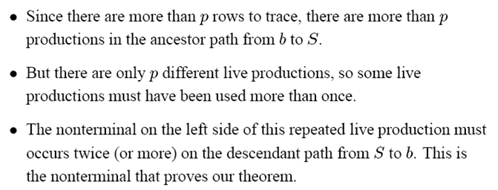
Proof of Theorem 33

Slide 14
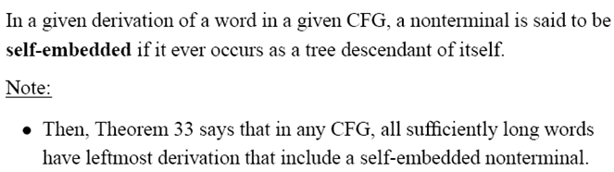
Self-embedded nonterminal

Slide 15
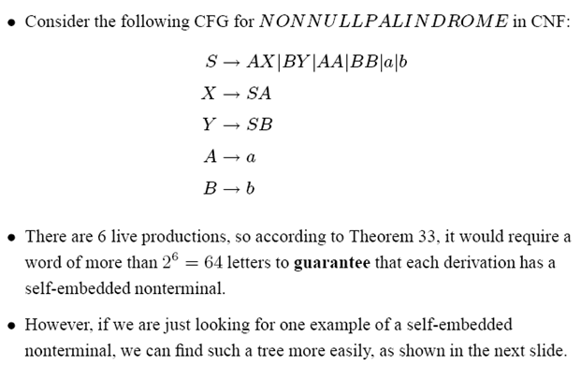
Example

Slide 16
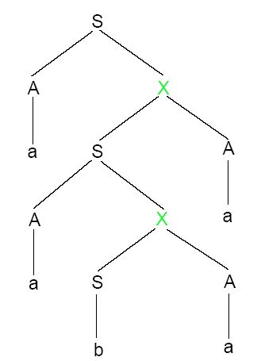
Here the Non-terminal X is self-embedded
This tree proceeds from S down to 1st X and to 2nd X
But once reached to 2nd X then it could be repeated, arriving at 3rd X e.g

Slide 17
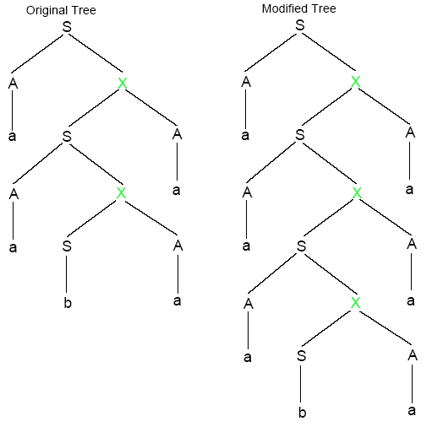

Slide 18
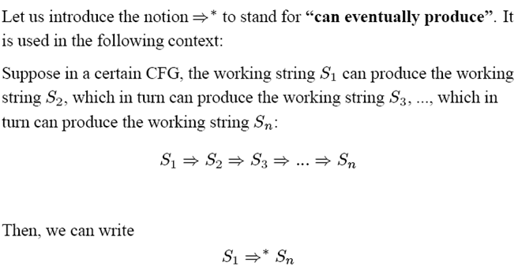
Notation

Slide 19
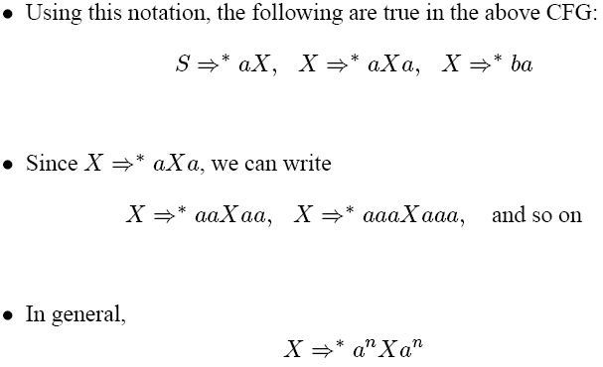

Slide 20
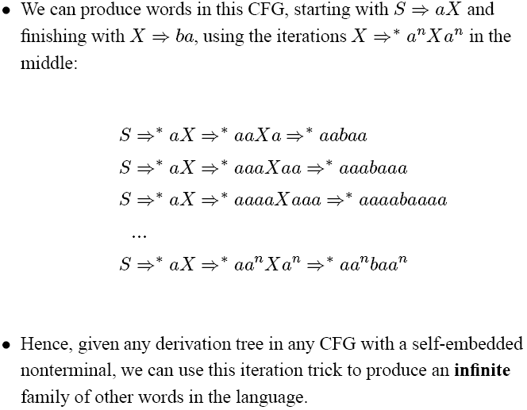

Slide 21
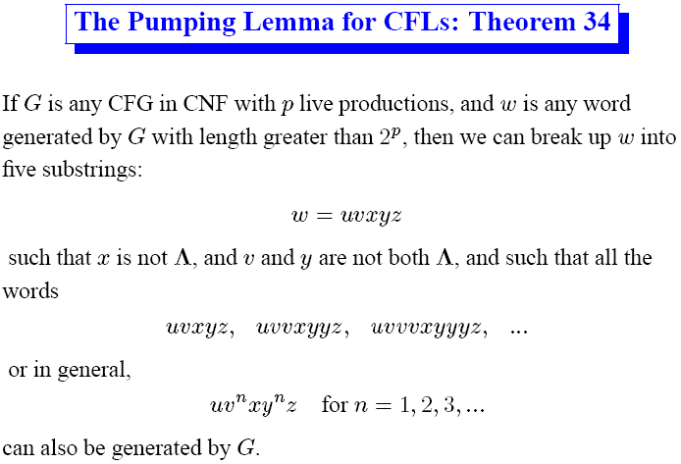

Slide 22
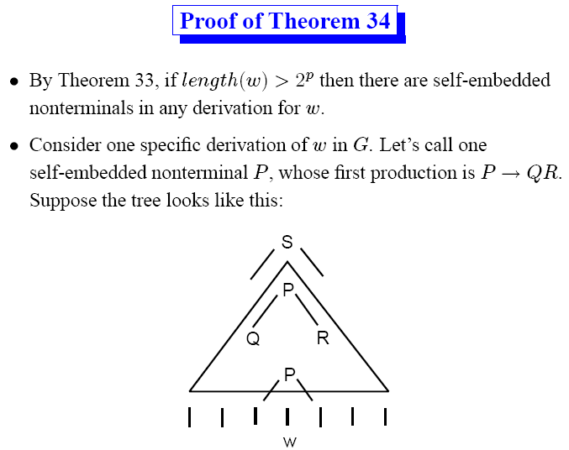

Slide 23
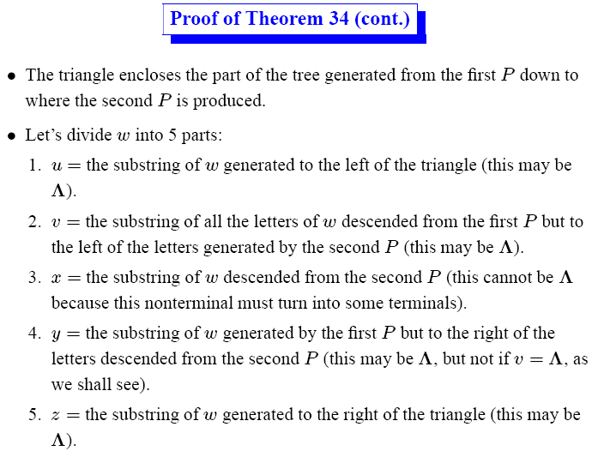

Slide 24
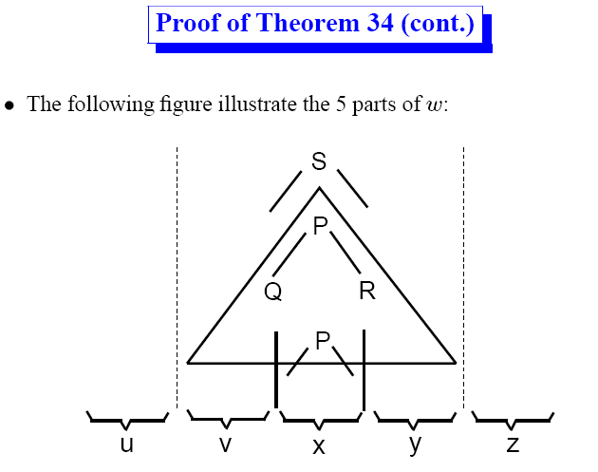

Slide 25
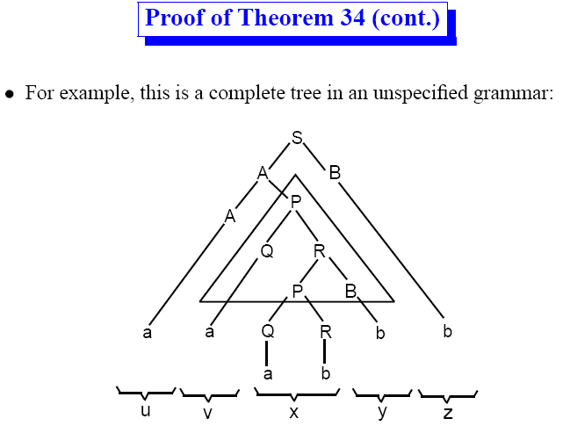

Slide 26
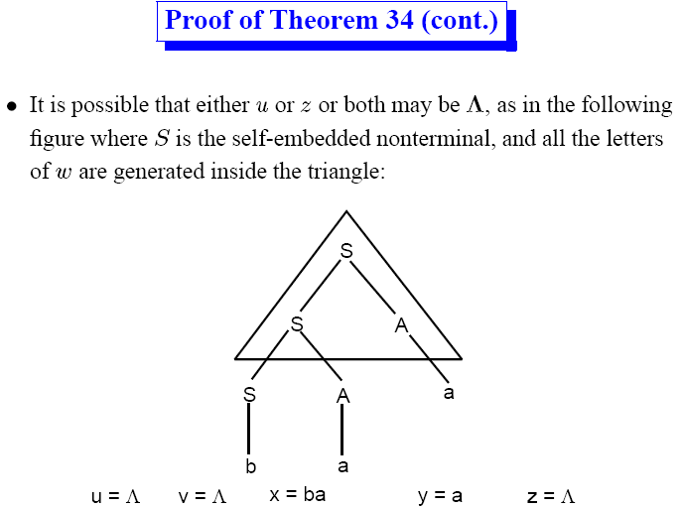

Slide 27
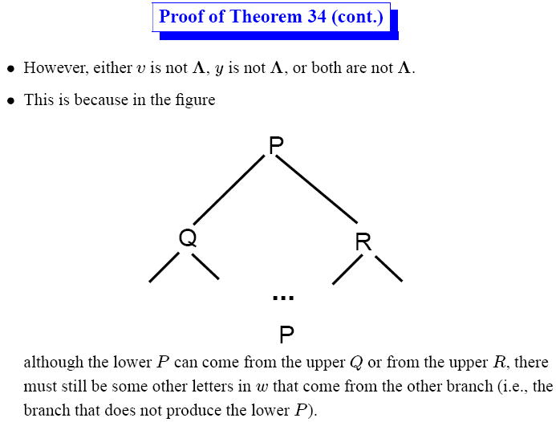

Slide 28
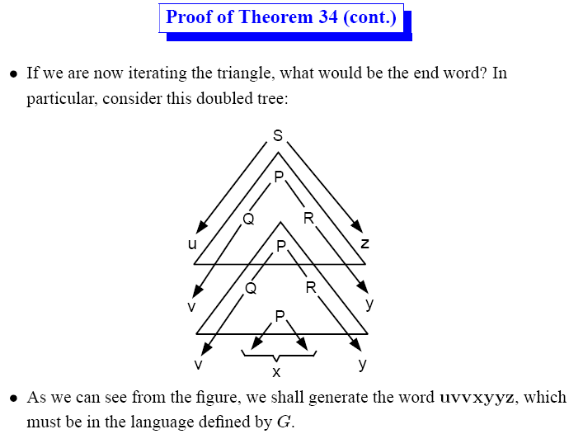

Slide 29
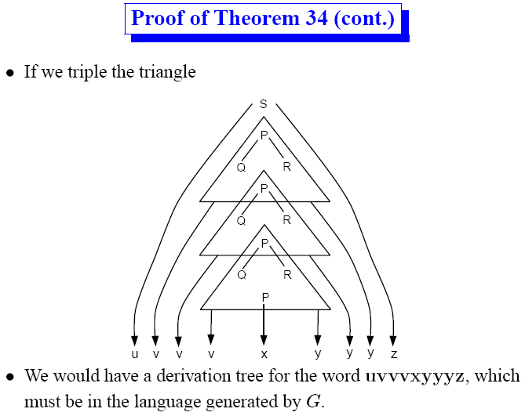

Slide 30
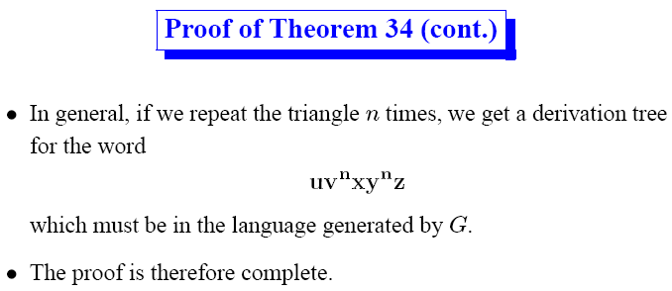

Slide 31
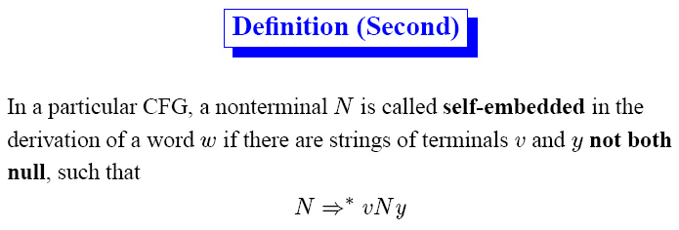

Slide 32
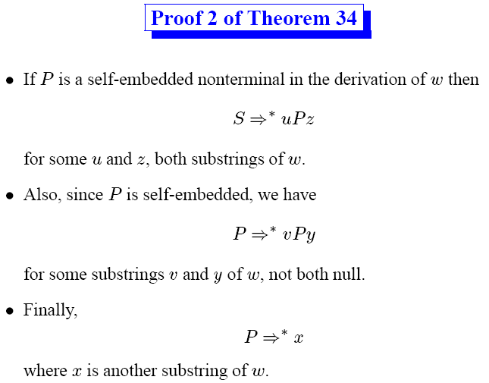

Slide 33
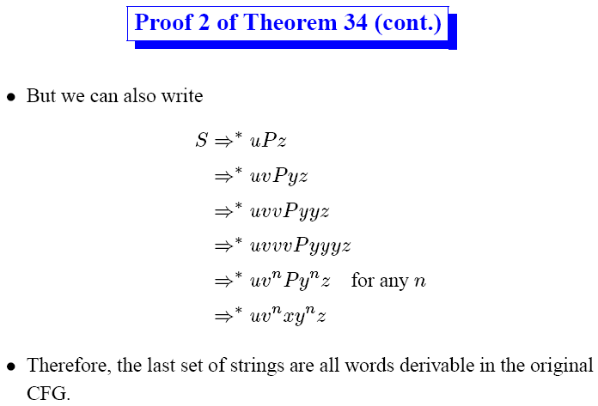

Slide 34
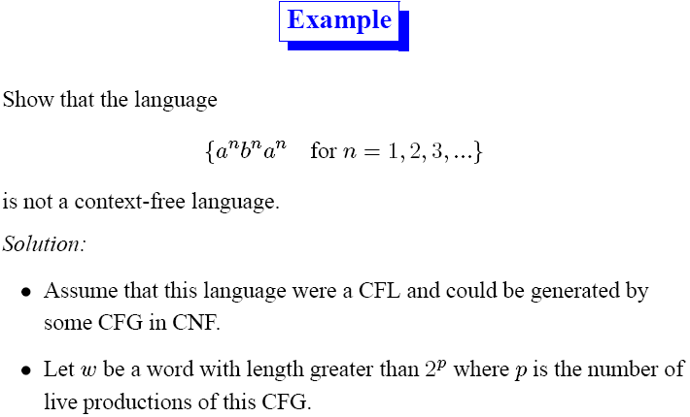
Notes:
Only one substring ab
Only one substring bc
No ac
No ba
Ca
Cb
For any n=1,2,3,..
34

Slide 35
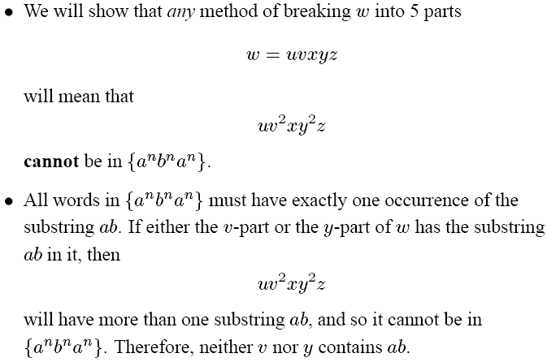

Slide 36
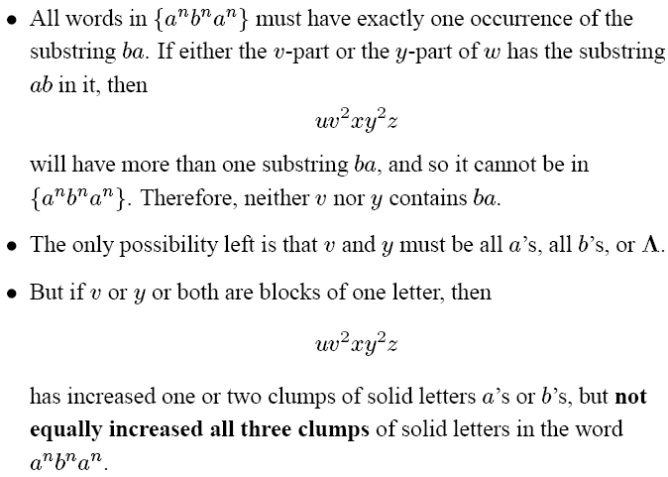

Slide 37
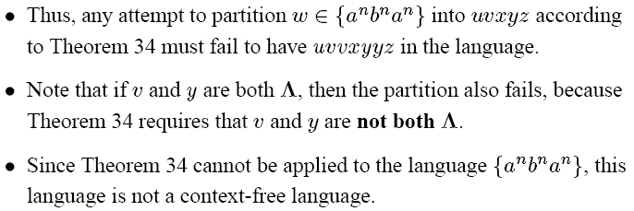

Slide 38
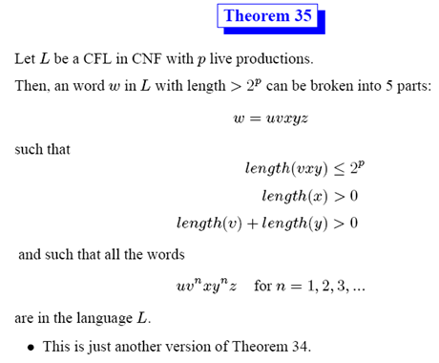

Slide 39
Another Way to Prove
The language {a^{n}b^{n}c^{n}} is not a CFL.
Proof: let G = (V, Σ, S, P) be any CFG, Σ = {a,b,c}
Suppose by way of contradiction that L(G) = {a^{n}b^{n}c^{n}} then G generates a pumping parse tree and for some k, a^{k}b^{k}c^{k} = uvwxy, where v and x are not both ε and uv²wx²y is in L(G)
v and x must each contain only as, only bs, or only cs; otherwise uv²wx²y is not even in L(a*b*c*)
So uv²wx²y has more than k copies or one or two symbols, but only k of the third
uv²wx²y ∉ {a^{n}b^{n}c^{n}}; by contradiction, L(G) ≠ {a^{n}b^{n}c^{n}}

Slide 40
The Insight
There must be some string in L(G) with a pumping parse tree: a^{k}b^{k}c^{k} = uvwxy
But no matter how you break up a^{k}b^{k}c^{k} into those substrings uvwxy (where v and x are not both ε) you can show uv²wx²y ∉ {a^{n}b^{n}c^{n}}
Either:
v or x has more than one kind of symbol
v and x have at most one kind of symbol each
Notes:
34

Slide 41
If v or x has more than one kind of symbol:
uv²wx²y would have as after bs and/or bs after cs
Not even in L(a*b*c*), so certainly not in {a^{n}b^{n}c^{n}}
Example:
If v and x have at most one kind each:
uv²wx²y has more of one or two, but not all three
Not in {a^{n}b^{n}c^{n}}
Example:
Notes:
34

Slide 42
{a^{n}b^{n}c^{n}} Is Not Context Free
Proof is by contradiction using the pumping lemma for context-free languages. Assume that L = {a^{n}b^{n}c^{n}} is context free, so the pumping lemma holds for L. Let k be as given by the pumping lemma.
Choose z = a^{k}b^{k}c^{k}. Now z ∈ L and |z| ≥ k as required.
3 Let u, v, w, x, and y be as given by the pumping lemma, so that uvwxy = a^{k}b^{k}c^{k}, v and x are not both ε, |vwx| ≤ k, and for all i, uv^{i}wx^{i}y ∈ L.
4 Now consider pumping with i = 2. The substrings v and x cannot contain more than one kind of symbol each—otherwise the string uv²wx²y would not even be in L(a*b*c*). So the substrings v and x must fall within the string a^{k}b^{k}c^{k} in one of these ways…
Notes:
34

Slide 43
{a^{n}b^{n}c^{n}}, Continued
But in all these cases, since v and x are not both ε, pumping changes the number of one or two of the symbols, but not all three. So uv²wx²y ∉ L.
This contradicts the pumping lemma. By contradiction, L = {a^{n}b^{n}c^{n}} is not context free.
Notes:
<number>

Slide 44
The language {a^{n}b^{m}c^{n} | m ≤ n} is not context free.
Proof: by contradiction using the pumping lemma
Assume L = {a^{n}b^{m}c^{n} | m ≤ n} is a CFL
Let k be as given by the pumping lemma
Choose z = a^{k}b^{k}c^{k}, so we have z ∈ L and |z| ≥ k
Now uvwxy = a^{k}b^{k}c^{k}, v and x are not both ε, |vwx| ≤ k , and for all i, uv^{i}wx^{i}y ∈ L
Now consider pumping with i = 2
v and x cannot contain more than one kind of symbol each; otherwise uv²wx²y ∉ L(a*b*c*)
That leaves 6 cases…
Notes:
<number>

Slide 45
But cases 1-5 have uv²wx²y ∉ L :
Case 1 has more as than cs
Case 2 has more as than cs, or more bs than cs, or both
Case 3 has more bs than as and more bs than cs
Case 4 has more bs than as, or more cs than as, or both
Case 5 has more cs than as and more cs than bs
And case 6 contradicts |vwx|≤k
By contradiction, L = {a^{n}b^{m}c^{n} | m ≤ n} is not a CFL
Notes:
<number>

Slide 46
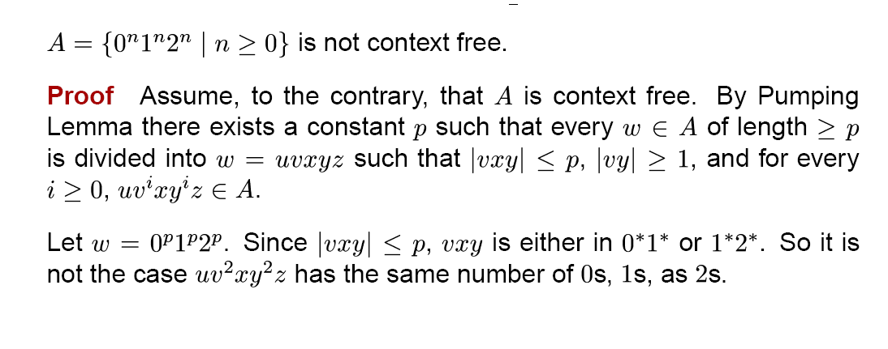

Slide 47
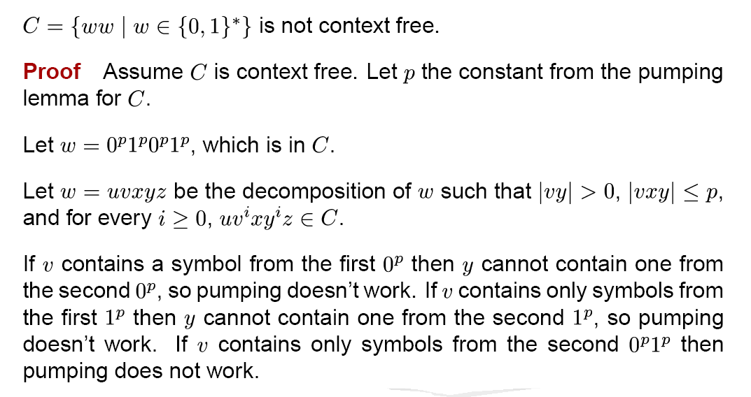

Slide 48
